Slide 1





Searching and Browsing TED Talks like Never Before
José Luis Redondo García – redondo@eurecom.fr
GO!
Raphaël Troncy –raphael.troncy@eurecom.fr
Mariella Sabatino –mariella.sabatino@eurecom.fr
Pasquale Lisena – pasquale.lisena@eurecom.fr

Slide 2
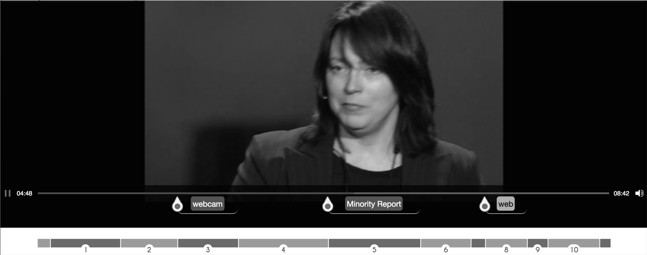
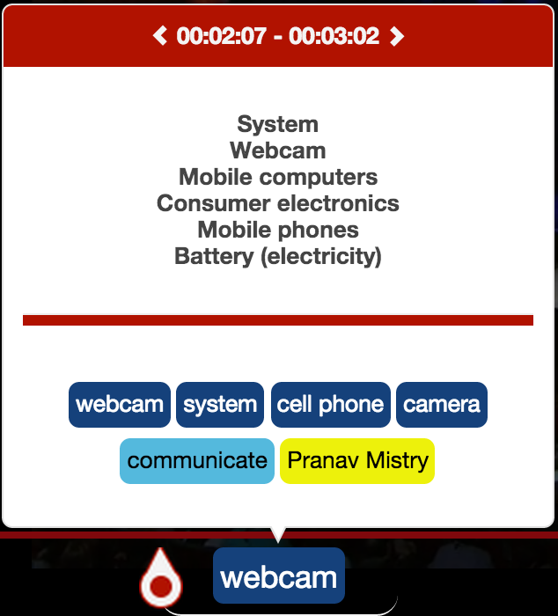
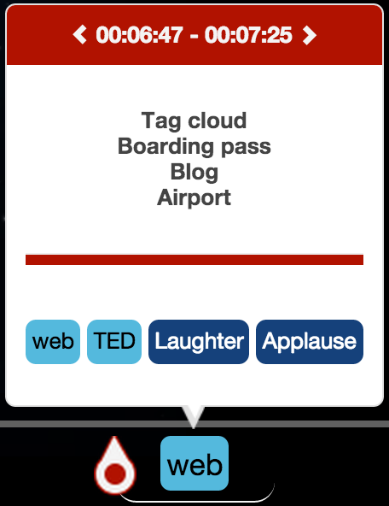



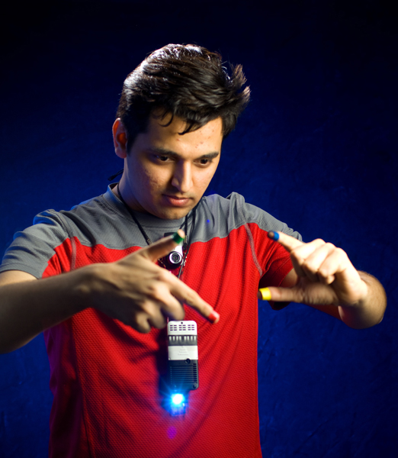
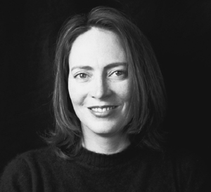


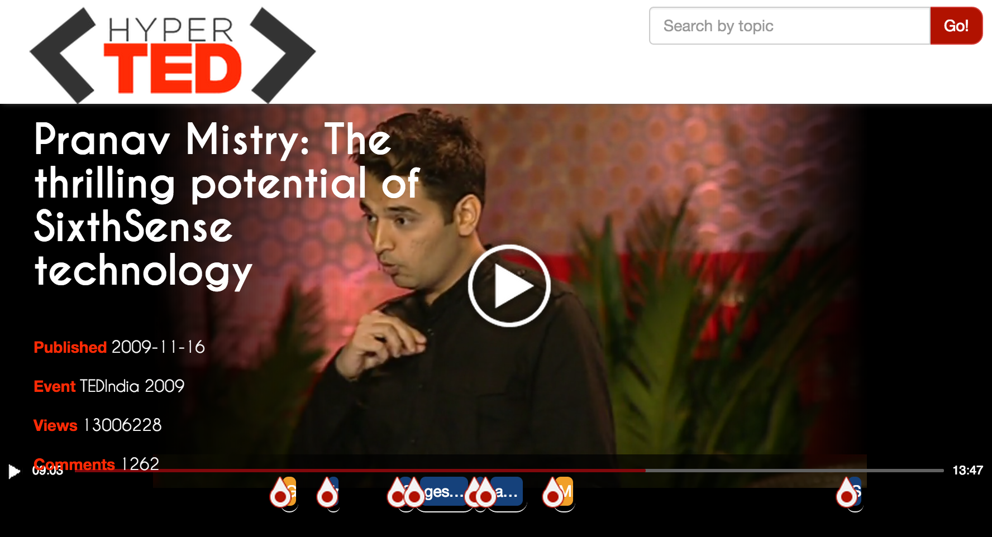

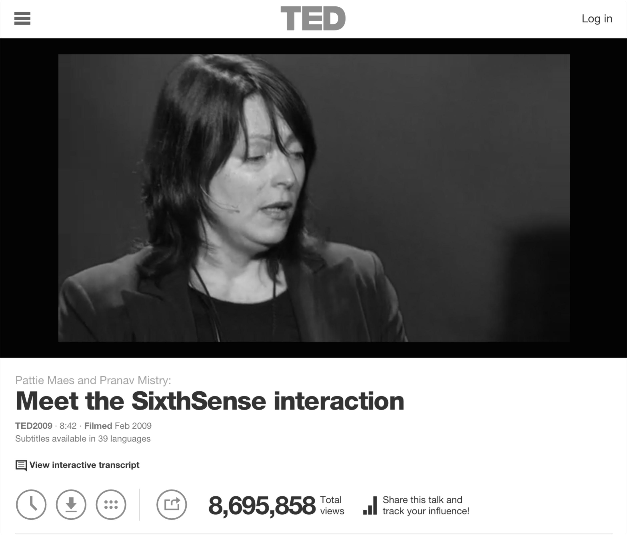




2014
Hot spots
Chapters
Entities
Related Ted’s Chapters
2006
.com
Courses
1984
Understanding environment:
A system approach
The Mysterious Field of Engineering Systems
Systems practice: Managing sustainability

Slide 3
New Consuming Paradigm
Can the video be divided into meaningful fragments?
How can those fragments be properly described?
Users overwhelmed with audio-visual content
How can users easily find related documents which complement the video
Which are the potentially relevant fragments ?

Slide 4
HyperTED
Media Fragment Support
Chapters
Hot Spots
MF Annotation
Named Entity Extraction
Topic Detection
Hyperlinking
Other TED talk’ chapters
Educational Online Resources

Slide 5
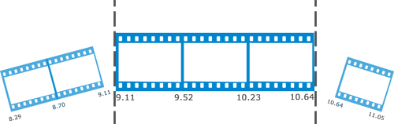
Media Fragments
A Media Fragment is a portion of a multimedia resource.
Temporal Fragments
sections along the time dimension of the media resource with a start and an end point.
http://www.w3.org/TR/media-frags/
http://www.w3.org/TR/media-frags/

Slide 6
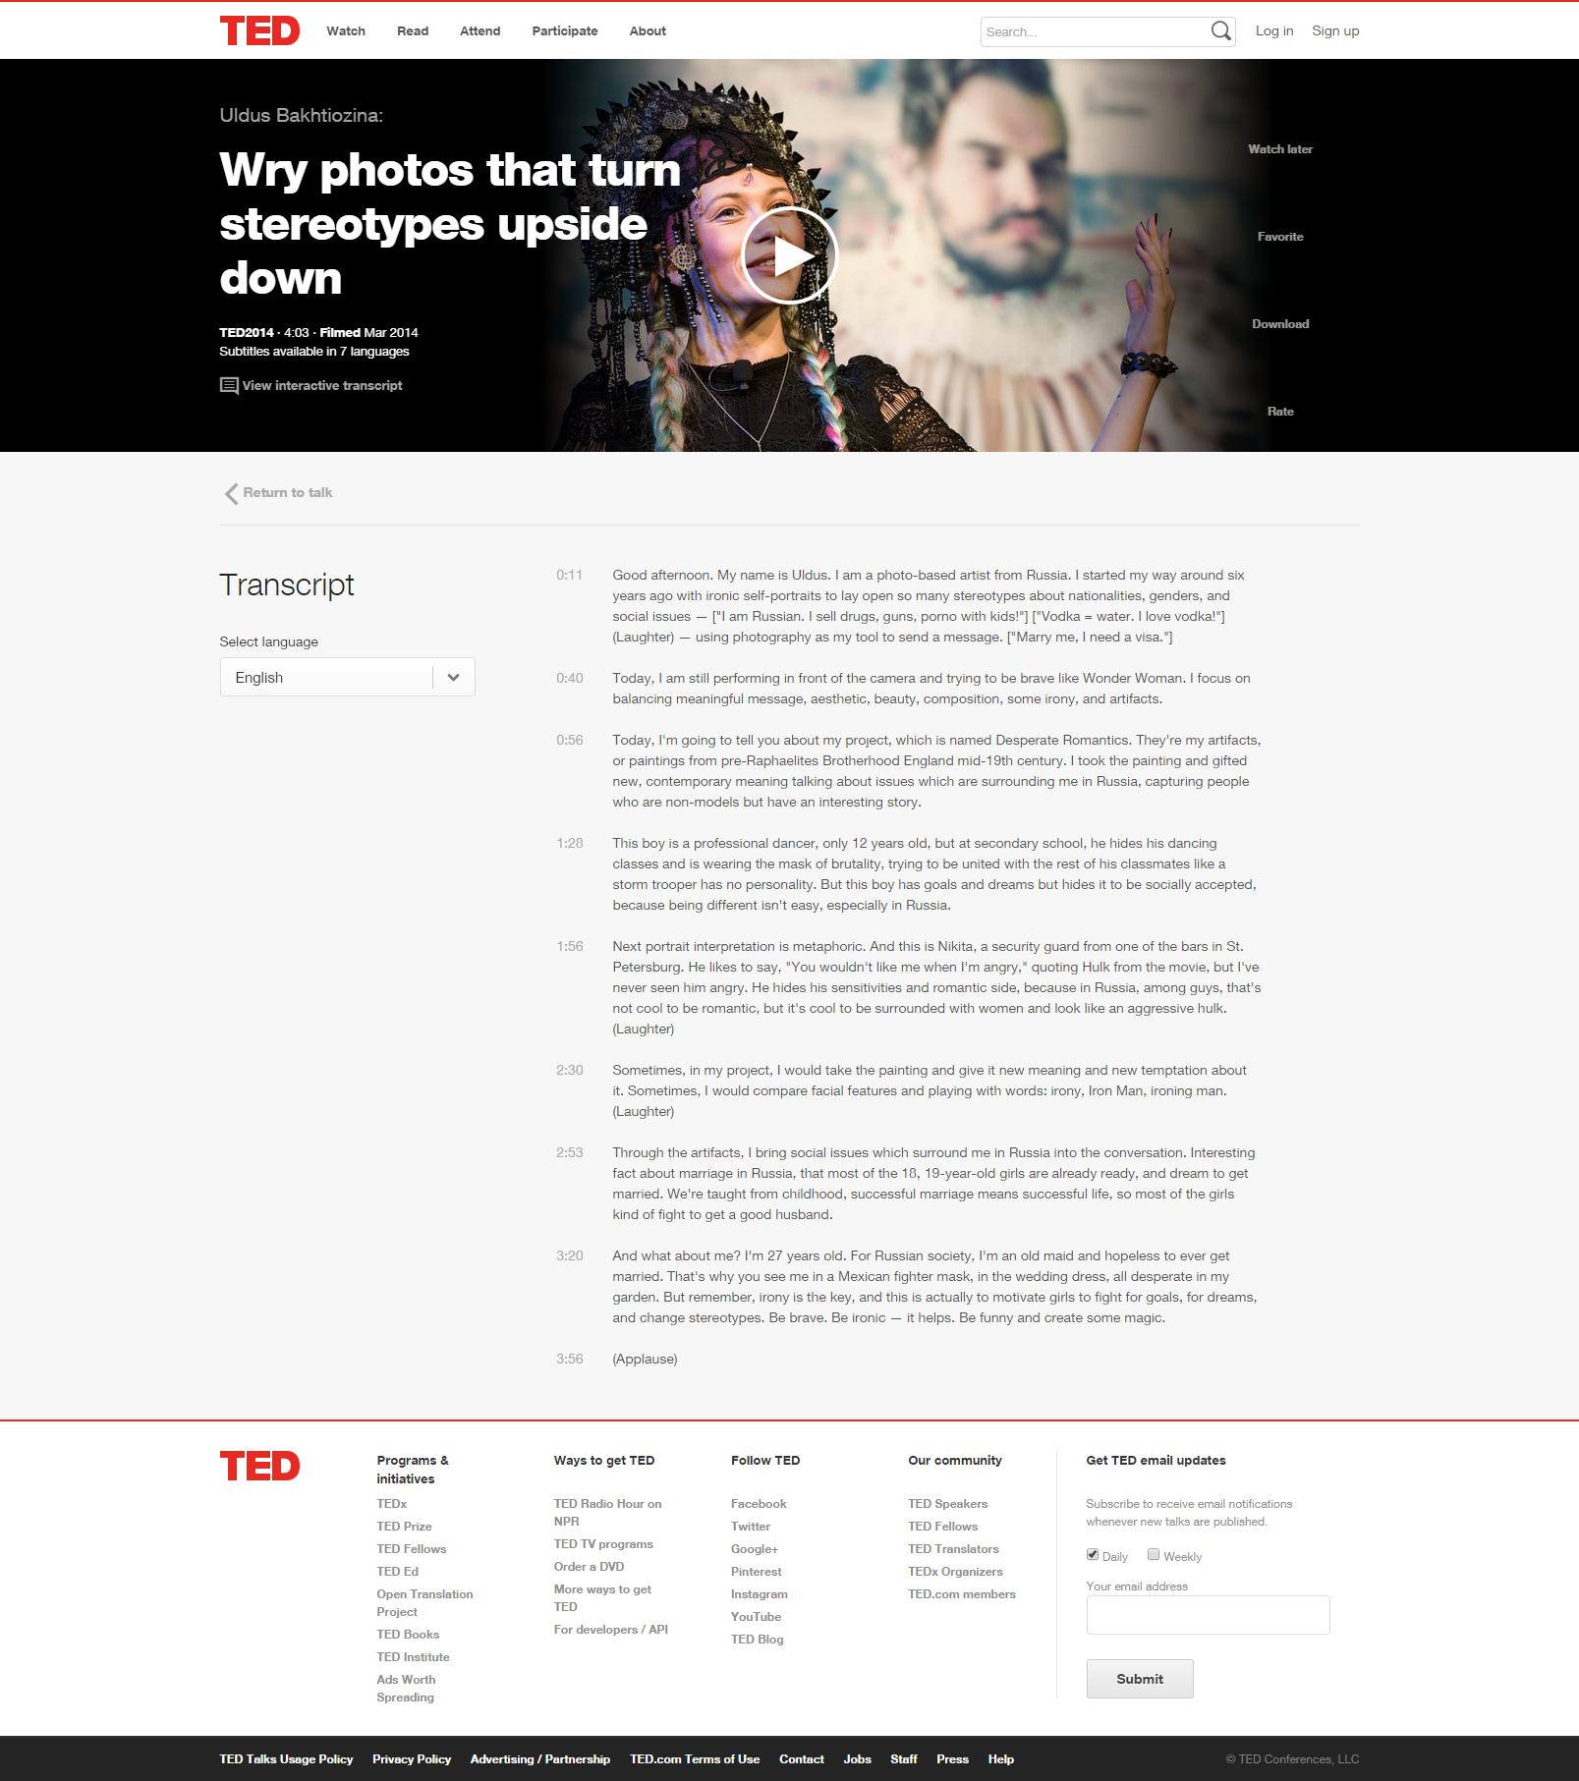
MF: Chapters
TED Talks have paragraphs:
a human-made subdivision of subtitles.

Slide 7
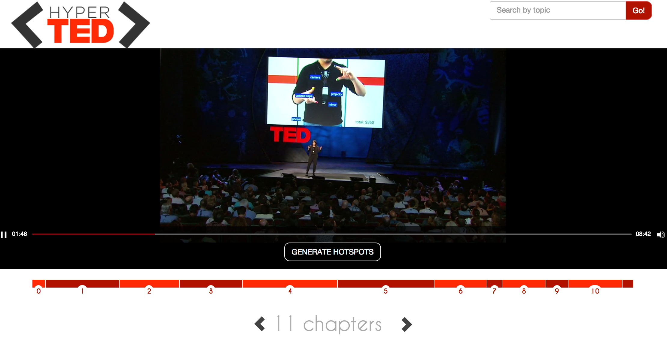
MF: Chapters

Slide 8


Annotations: Named Entities
“This is Nikita, a security guard from one of the bars in St. Petersburg.”
NER
“This is Nikita, a security guard from one of the bars in St. Petersburg.”
PERSON
Natural Language Processing (NPL) Task → disambiguating URL in a knowledge base.
E.g. http://dbpedia.org/resource/Saint_Petersburg.
Category:
type in the NER task.
FUNCTION
LOCATION
Example taken from the transcript of
https://www.ted.com/talks/2089

Slide 9










NER Extractors
Web Tools that expose NER algorithms.
Open APIs for research use.

Slide 10

NERD
Integrates different NER tools available on Web.
Unify NER extractors in a common output.
http://nerd.eurecom.fr/

Slide 11
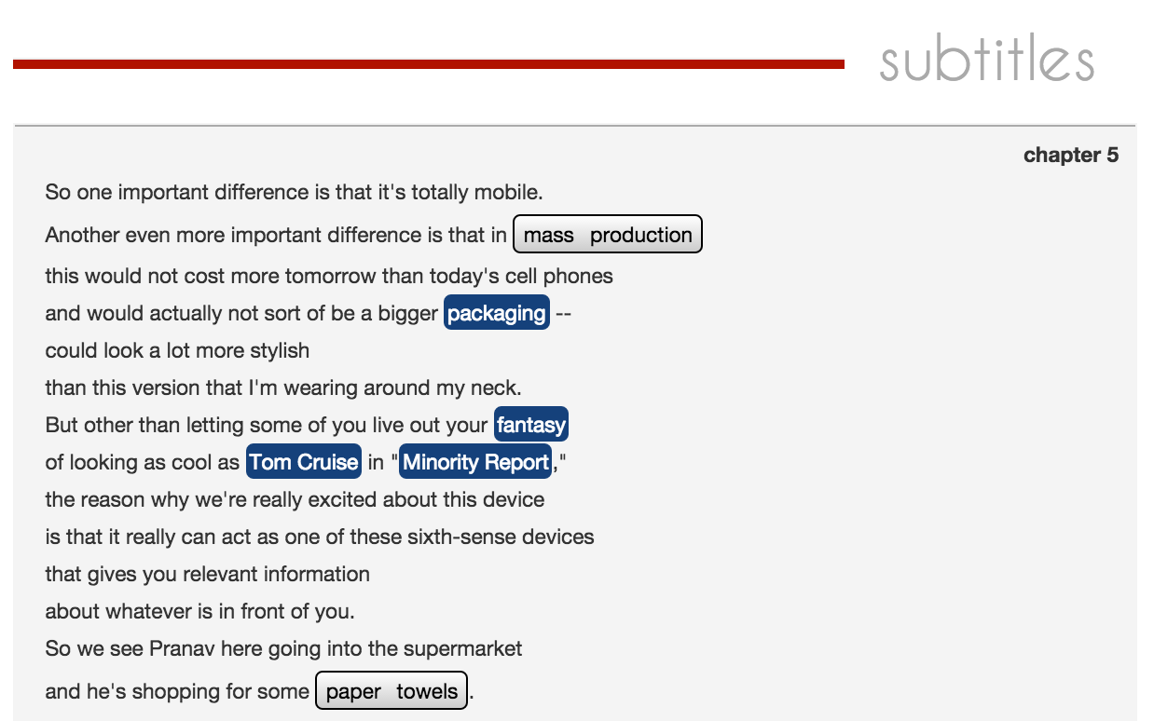
Annotation: Named Entities

Slide 12
Annotation: Topics
Chapter 3
“I'm wearing a camera, just a simple webcam, a portable, battery-powered projection system with a little mirror. These components communicate to my cell phone in my pocket which acts as the communication and computation device. And in the video here we see my student Pranav Mistry, who's really the genius who's been implementing and designing this whole system...”
Consumer electronics
Battery (electricity)
Mobile computers
Example taken from the transcript of
https://www.ted.com/talks/pattie_maes_demos_the_sixth_sense

Slide 13
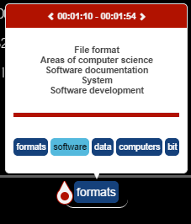
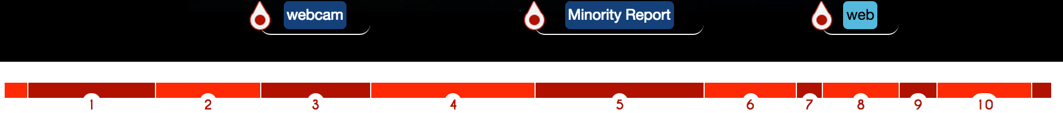
MF: Hot Spots
Hot Spot 2
annotations
Clustering of consecutive Chapters which talk about similar topics and Entities
Ordering of those fragments based on annotation relevance (TF-IDF)
Filtering: The Hot Spots are fragments whose relative relevance falls under the first quarter of the final score distribution.
Hot Spot 1
annotations
Hot Spots
Chapters

Slide 14
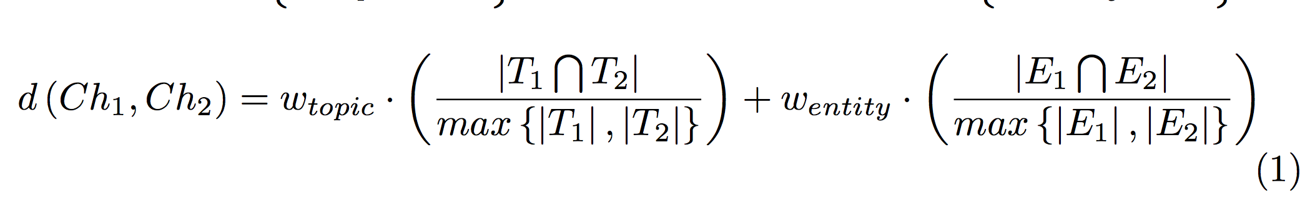
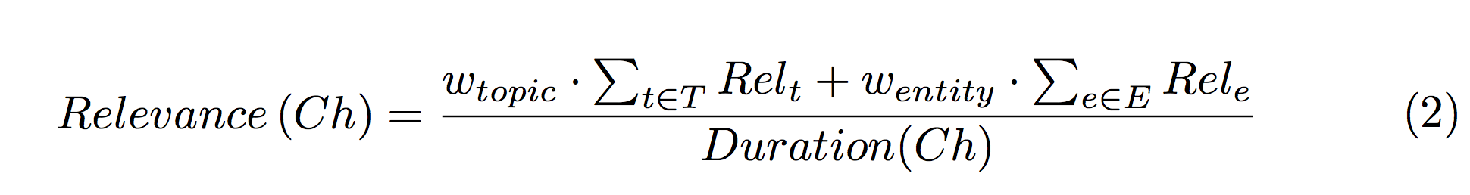
MF: Hot Spots
Clustering of consecutive Chapters which talk about similar topics and Entities
Ordering of those fragments based on annotation relevance (TF-IDF)
Filtering: fragments whose relative relevance falls under the first quarter

Slide 15
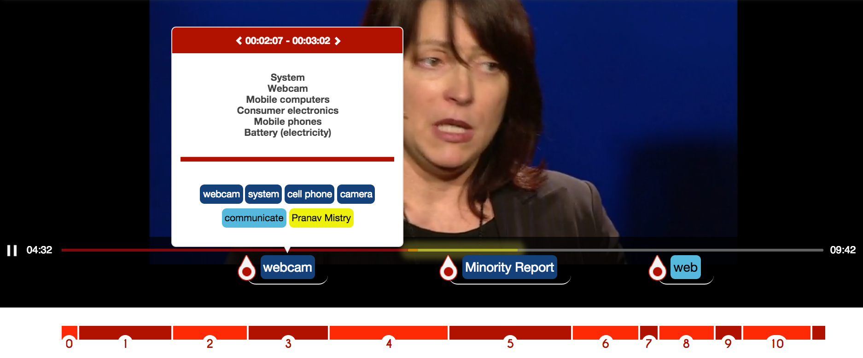
MF: Hot Spots

Slide 16
Hyperlink: Indexing TED Talks
Granularity level:
Chapter
Indexed Features:
Topics
Entities
timing references (startNPT and endNPT);
Relevance indexes.
UUID of the resource;
Transcript

Slide 17

Hyperlink: Indexing TED Talks
Index Engine:
ElasticSearch is an open-source search engine.
Uses Apache Lucene™ for indexing.
It aims to make full text search easy by hiding the complexities of Lucene behind a simple RESTful API.

Slide 18
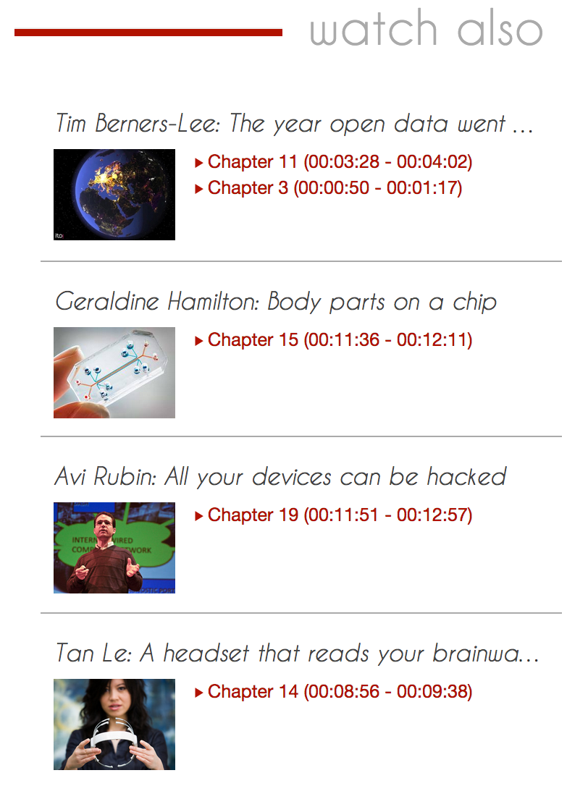
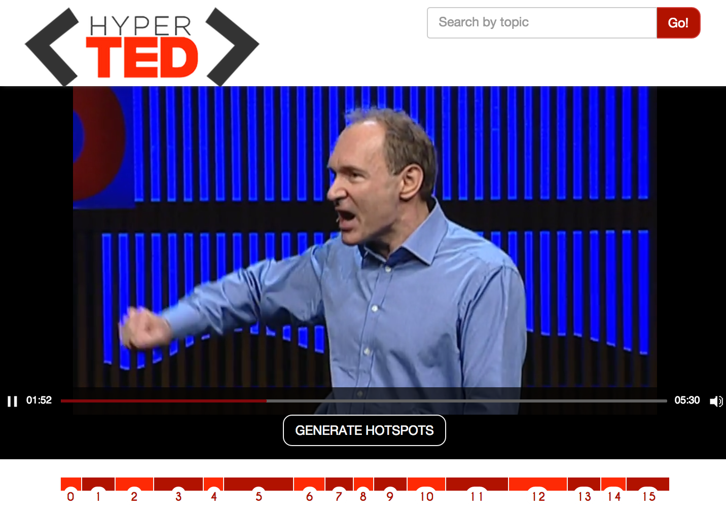
Hyperlink: Indexing TED Talks

Slide 19
Hyperlink: Finding related Courses
Datasets :
Open Courseware
Open University
Anchors used in search:
Entities Too specific.
Topics Courses about the same thematic
Attributes used in search:
Title
Description
Subject, thematic…
SPARQL is not a IR Language

Slide 20
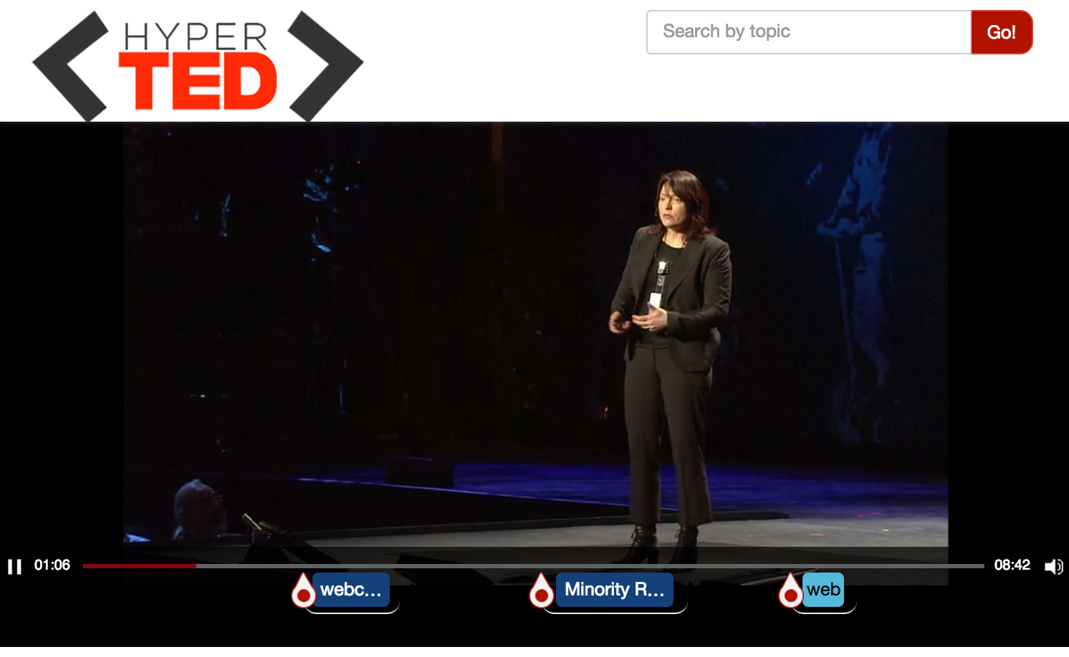
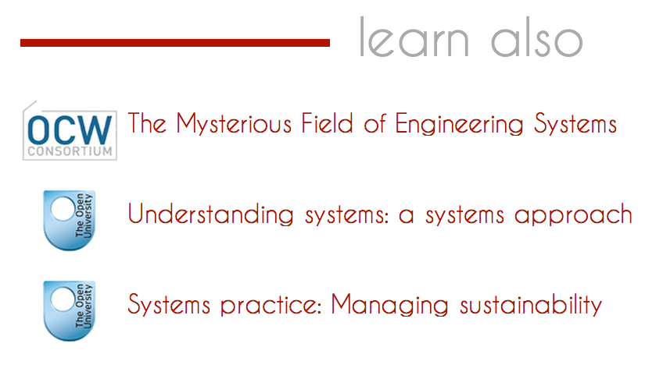
Hyperlink: Finding related Courses

Slide 21
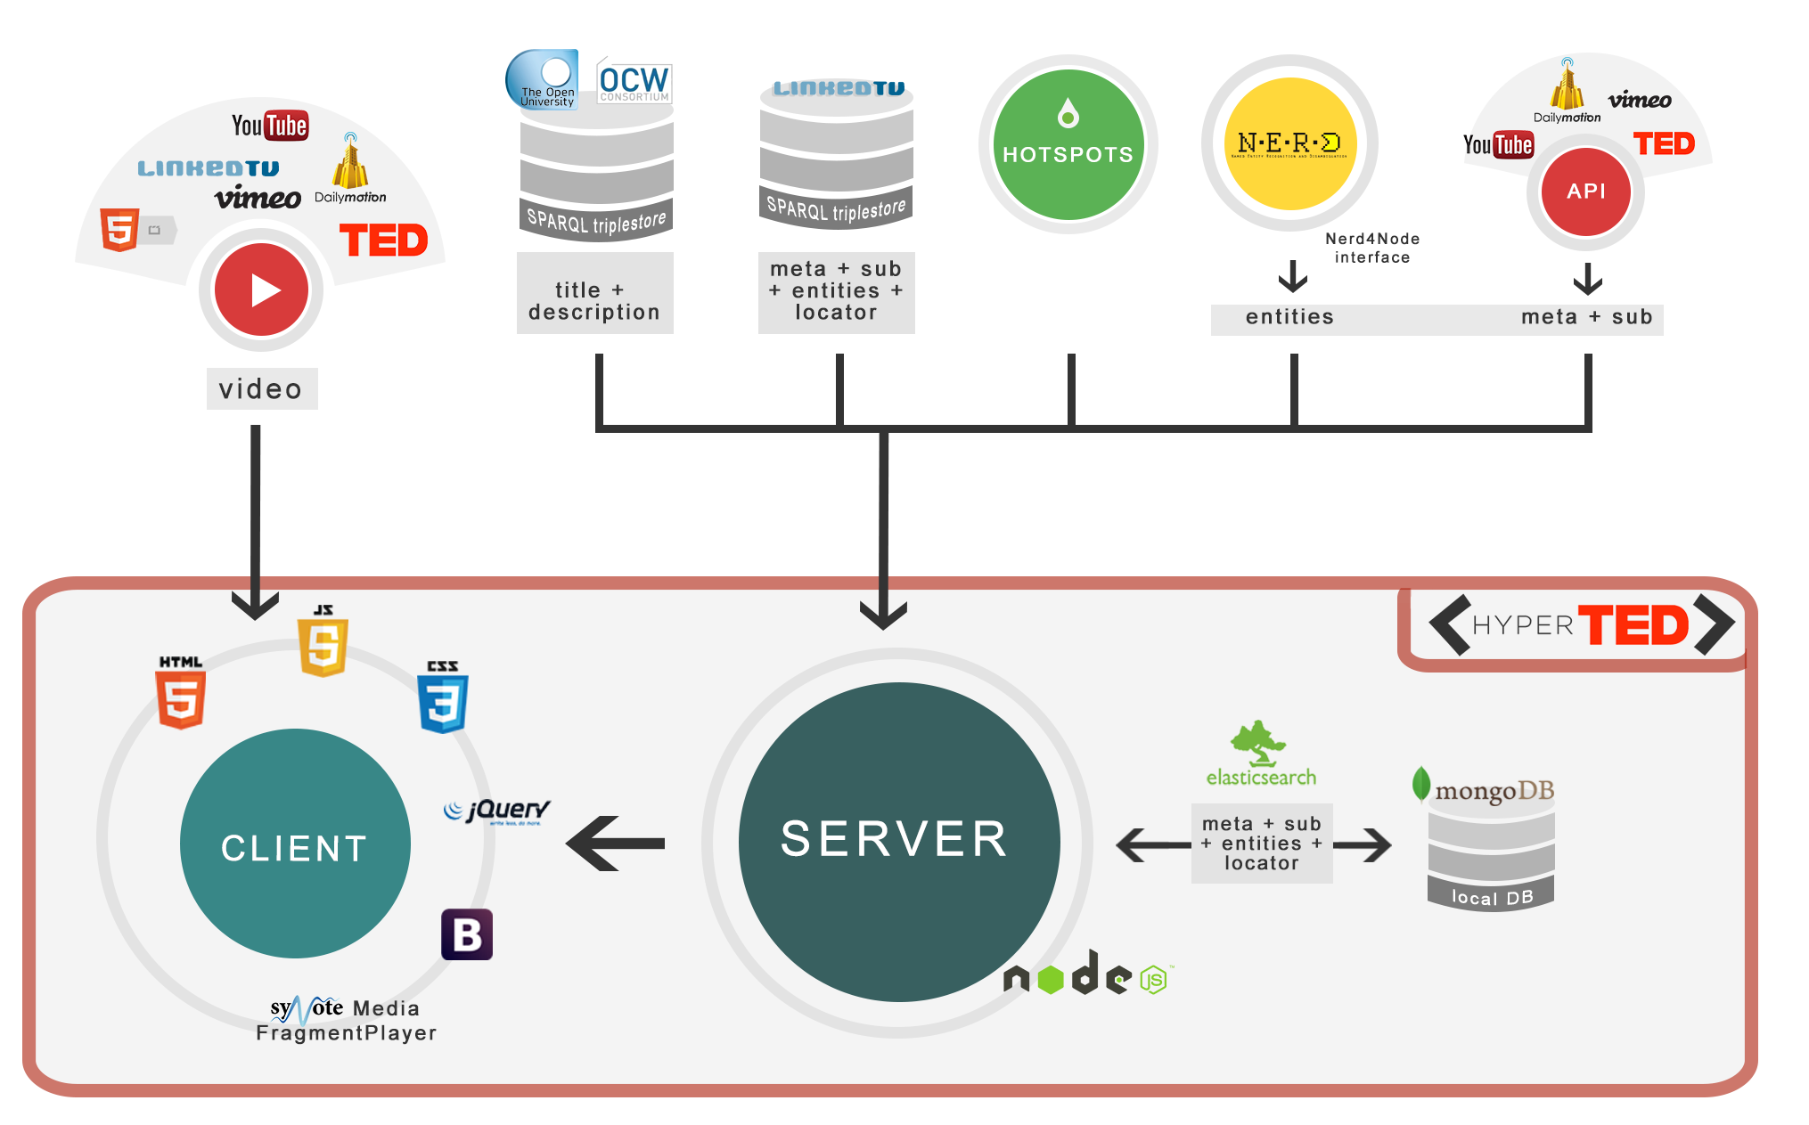
Architecture

Slide 22
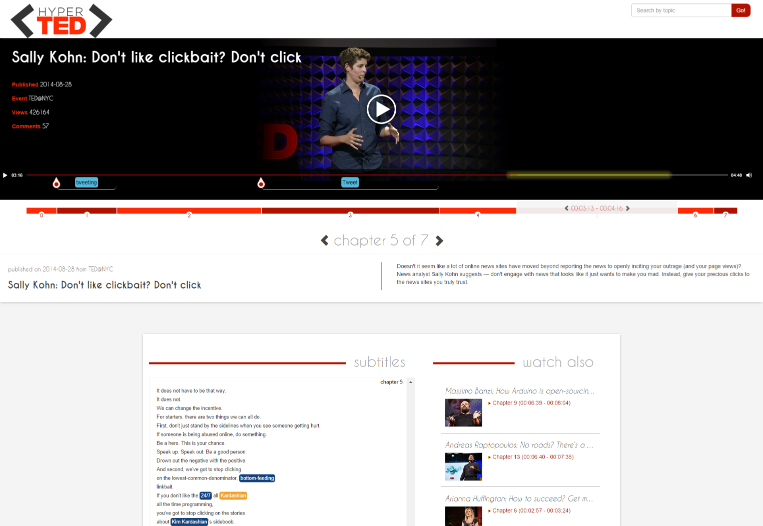
DEMO time
http://linkedtv.eurecom.fr/mediafragmentplayer

Slide 23
Conclusions
Media Fragment player
Hot Spots detection based on topics and entities
Hyperlinking between chapters of TED talks + external education resources.
Responsive and Web compliant UI

Slide 24
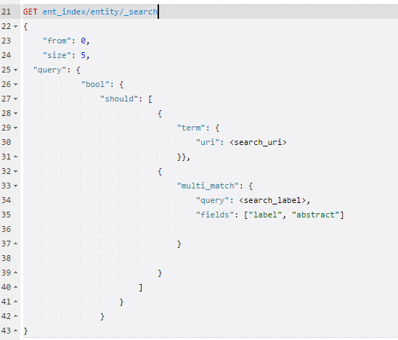
1
2
3
ElasticSearch
HOW TO MAKE A QUERY
ElasticSearch provides a full Query DSL based on JSON to define queries. In general, there are basic queries such as term or prefix.

Slide 25

TED Talks
TED is a global set of conferences, held throughout North America, Europe and Asia.
TED Talks address a wide range of topics within the research and practice of science and culture.
The speakers are given a maximum of 18 minutes to present their ideas in the most innovative and engaging way they can, often through storytelling.

Slide 26
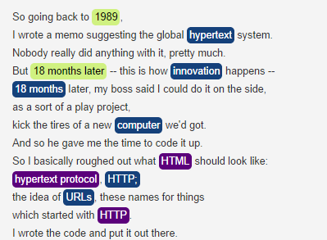
1
2
3
What is a NER task?
Named Entity Recognition (NER) aims to locate and classify elements of textual document into
pre-defined categories such as:
People names;
Organizations names;
Places;
Temporal and numerical expressions.
These elements and the categories take respectively the name of entities and ontologies.

